Slide 1

CODE DESIGNER
Submitted By:
PRIYANK SHAH (100080116009)
JAYESH DUDHAT (110083116003)
SOHAL PATEL (110083116007)
PARTH NAKUM (110083116009)
College Guide:
PROF. KEYUR BRAHMBHATT
PROF. VISHAL POLARA
Company Guide:
MR. ANAND TRIVEDI
INFORMATION TECHNOLOGY
BIRLA VISHAVKARMA MAHAVIDHYALA ENGINEERING COLLEGE Vallabh VidhyaNagar

Slide 2
IDP INFORMATION
COMPANY NAME :
‘Shiva Software Solutions.’
LOCATION :
GF-31, Saffron Tower, FatehGunj, Vadodara
Gujarat 390002.
OWNER/GUIDE NAME :
‘Mr. Anand Trivedi’
CONTACT NO :
0265-6591188

Slide 3
OUTLINE
USER REQUIREMENTS AND WHY THIS PROJECT
WHAT IS “CODE DESIGNER”
OBJECTIVES OF CODE DESIGNER
FRONT-END, BACK-END
SYSTEM REQUIREMENTS
MODULES
GRAPHICAL USER INTERFACE

Slide 4
USER REQUIREMENTS
AND
WHY THIS PROJECT ?

Slide 5
USER REQUIREMENTS AND WHY THIS PROJECT…
A bunch of programming languages
Gradually increment in the graph of popularity of JAVA language.
Strong Features of J2EE application compare to other language .
Security & Platform independent
But the complexity of the language code
Unable to design J2EE application if one is not a professional in J2SE and J2EE.
Need of an application which will provide the platform for designing the J2EE apps without being professional in JAVA field.
Need of an application which will design J2EE apps with basic programming language knowledge .

Slide 6
USER REQUIREMENTS AND WHY THIS PROJECT…
Project “CODE DESIGNER” is chosen by us, they gives a complete platform for such users.
Inside it, a GUI interface to application user who are just aware about basic programming logics & having knowledge about programming algorithms.
CODE DESIGNER is itself a J2EE application and holds all pros of JAVA.

Slide 7
WHAT
IS
“CODE DESIGNER”

Slide 8
WHAT IS “CODE DESIGNER”…
If I give a simple abstraction of “CODE DESIGNER” project then “CODE DESIGNER” is a J2EE application which will provide the user friendly GUI and platform to user, who is not a professional leveled java programmer, to develop a JAVA application .
User can develop an application by designing only flowchart of program logic.

Slide 9
OBJECTIVES
OF
“CODE DESIGNER”

Slide 10
OBJECTIVES OF CODE DESIGNER…
Provide an IDE to user for develop JAVA application.
Reduce the complexity in database interaction.
Reduce the complexity of SQL Queries.
Provide the attractive and User friendly GUI .
Provide the functionalities to User like create the project and decides the milestones of it.
Generate the JAVA code according to design of flowchart developed by user .
Increase the level of interaction among project partners.

Slide 11
FRONT-END & BACK-END

Slide 12
FRONT – END & BACK - END
FRONT – END :
JAVA
BACK – END:
MySQL

Slide 13
SYSTEM REQUIREMENTS

Slide 14
SYSTEM REQUIREMENTS…
HARDWARE REQUIREMENTS
Processor - Intel Pentium IV or higher or Similar
RAM - 1 GB (Minimum)
Disk Space - 10 GB
SOFTWARE REQUIREMENTS
Operating System : Any
Used Technology : JAVA jre 6
Tools used : MY SQL DATABASE

Slide 15
MODULES
OF
“CODE DESIGNER”

Slide 16
MODULES OF “CODE DESIGNER”
Tools Window
Designing Window
Database Designer
Algorithm Designer
Editor or Coding Window
Explorer Window
Output View
Desktop Sharing Module
Communication Window (Chat)

Slide 17
MODULE – I
TOOLS WINDOW

Slide 18
TOOLS WINDOW…
Main Application Window
Drag & Drop Tools
Menu bar
Tools box

Slide 19
MODULE – II
DESIGNING WINDOW

Slide 20
DESIGNING WINDOW…
Database Designer
Flow Chart Designer

Slide 21
MODULE – III
EDITOR OR CODING WINDOW

Slide 22
Editor or Coding Window…
Code Window
Editor
Auto Completer
.java Extensions

Slide 23
MODULE – IV
EXPLORER WINDOW

Slide 24
Explorer Window…
Database Explorer Window
Project View
Edit Project

Slide 25
MODULE – V
OUTPUT VIEW

Slide 26
output Window…
Compile Code
Run/Execute Code
Shortcuts
Output result

Slide 27
MODULE – VI
ADDITIONAL MODULES

Slide 28
DESKTOP SHARING MODULE…
Create session
Join session
COMMUNICATION WINDOW (CHAT)…
Invite to chat
Join chat

Slide 29
GRAPHICAL USER INTERFACE
OF
THE CODE DESIGNER APPLICATION

Slide 30
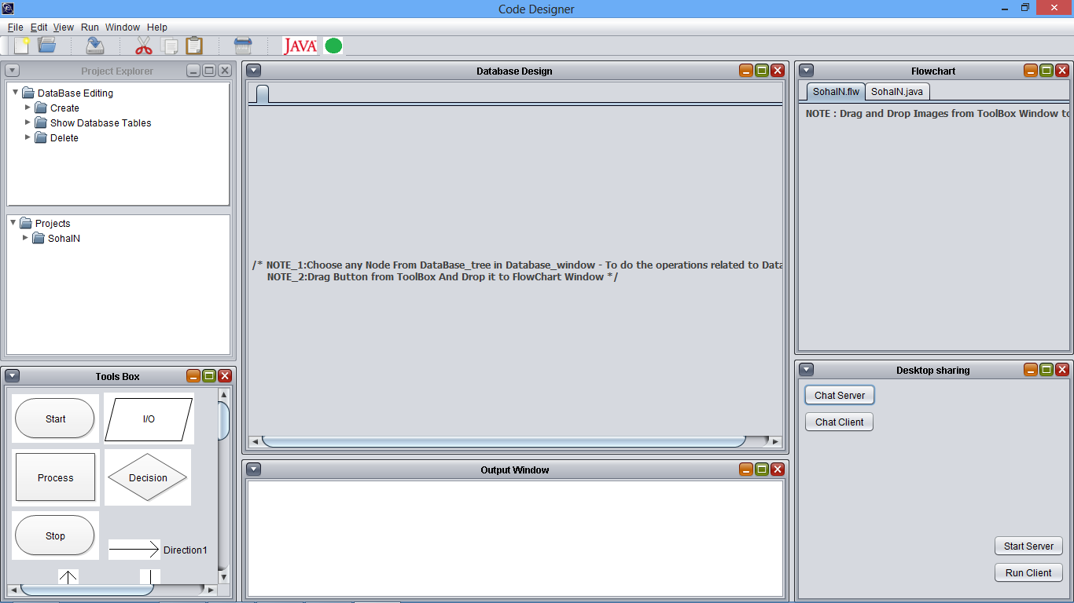

Slide 31
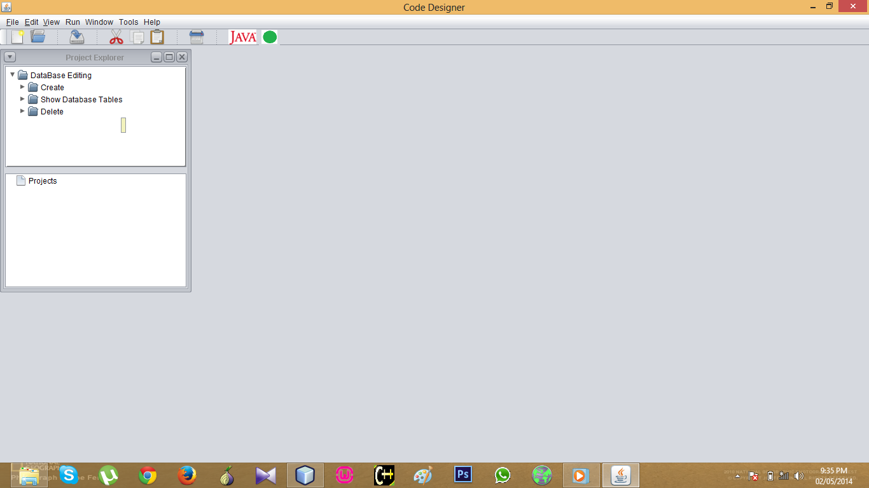

Slide 32
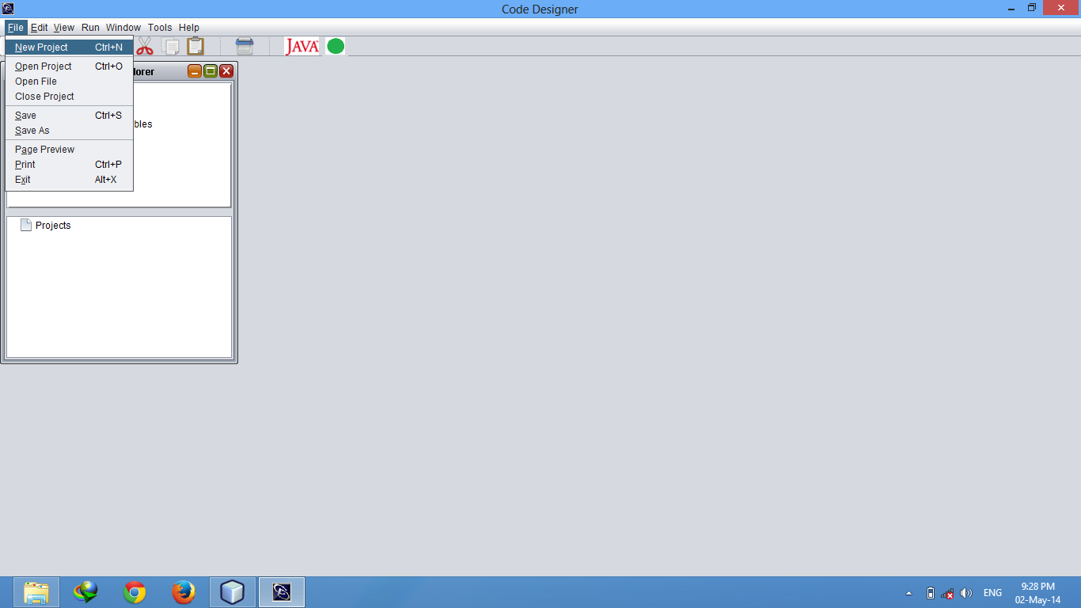

Slide 33
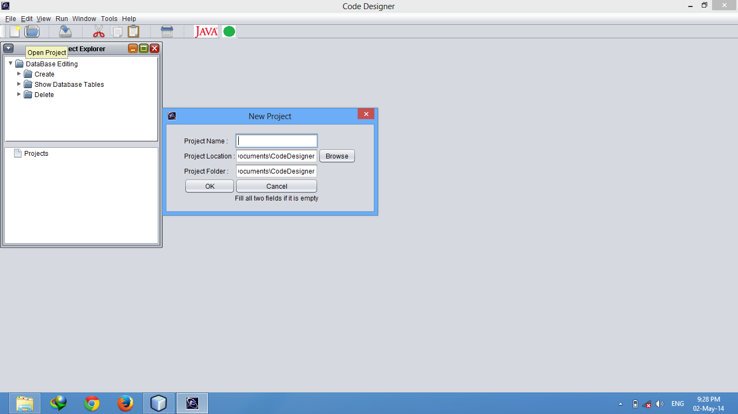

Slide 34
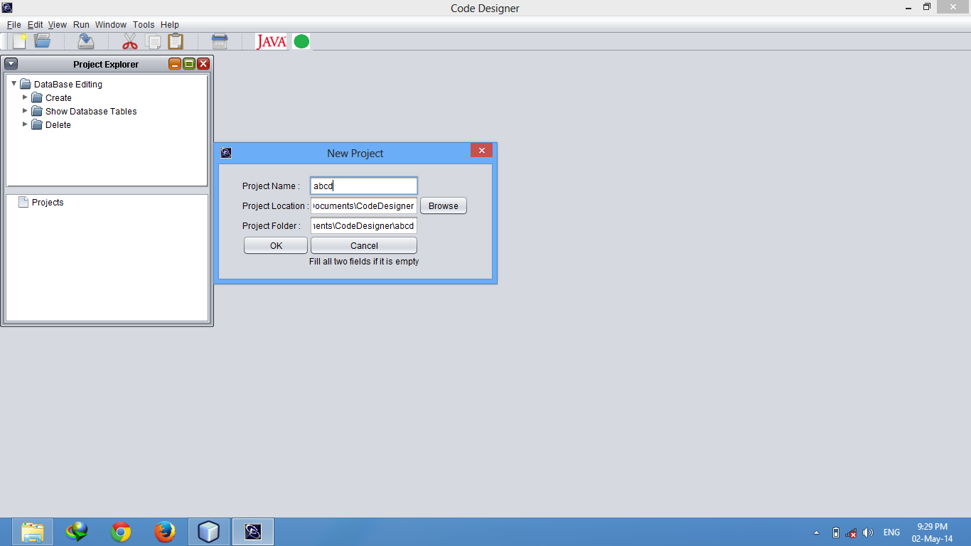

Slide 35
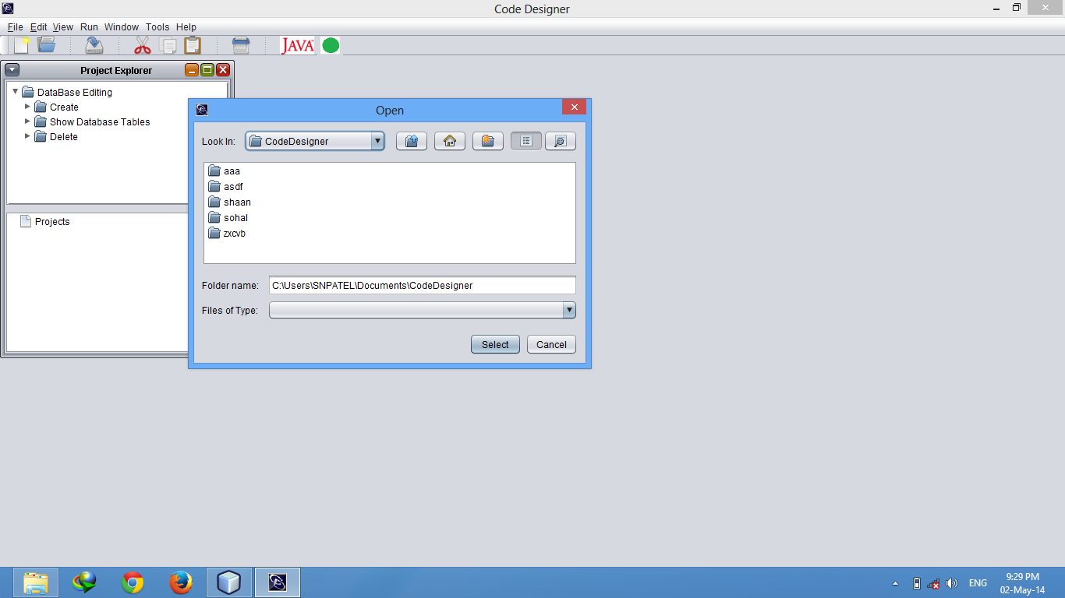

Slide 36
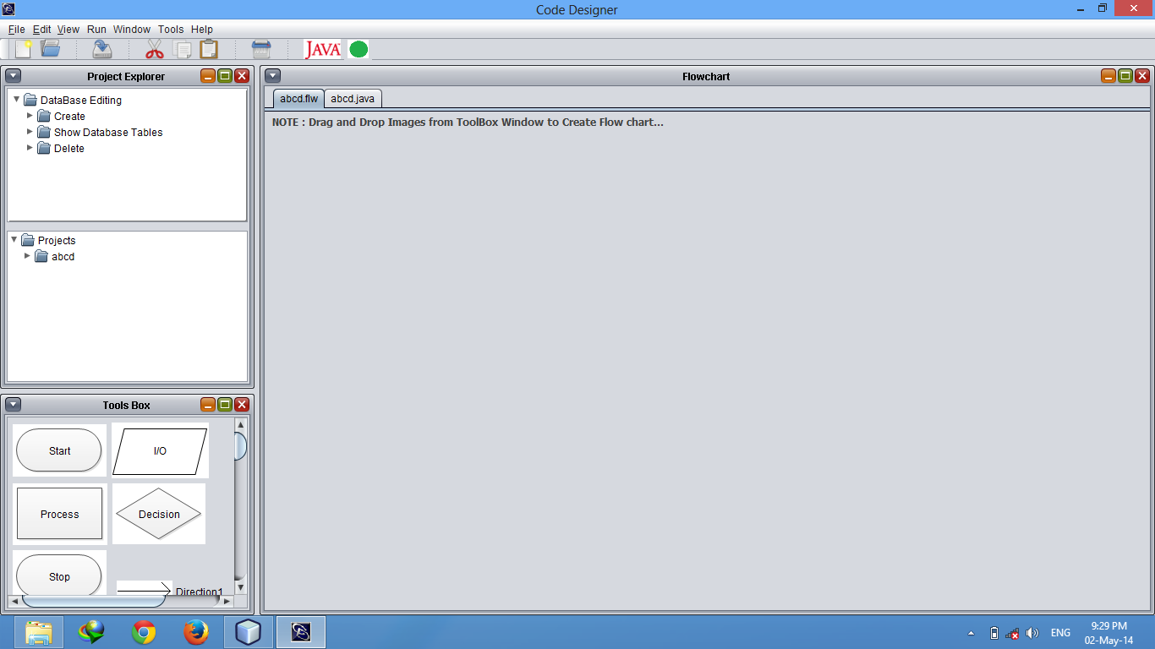

Slide 37
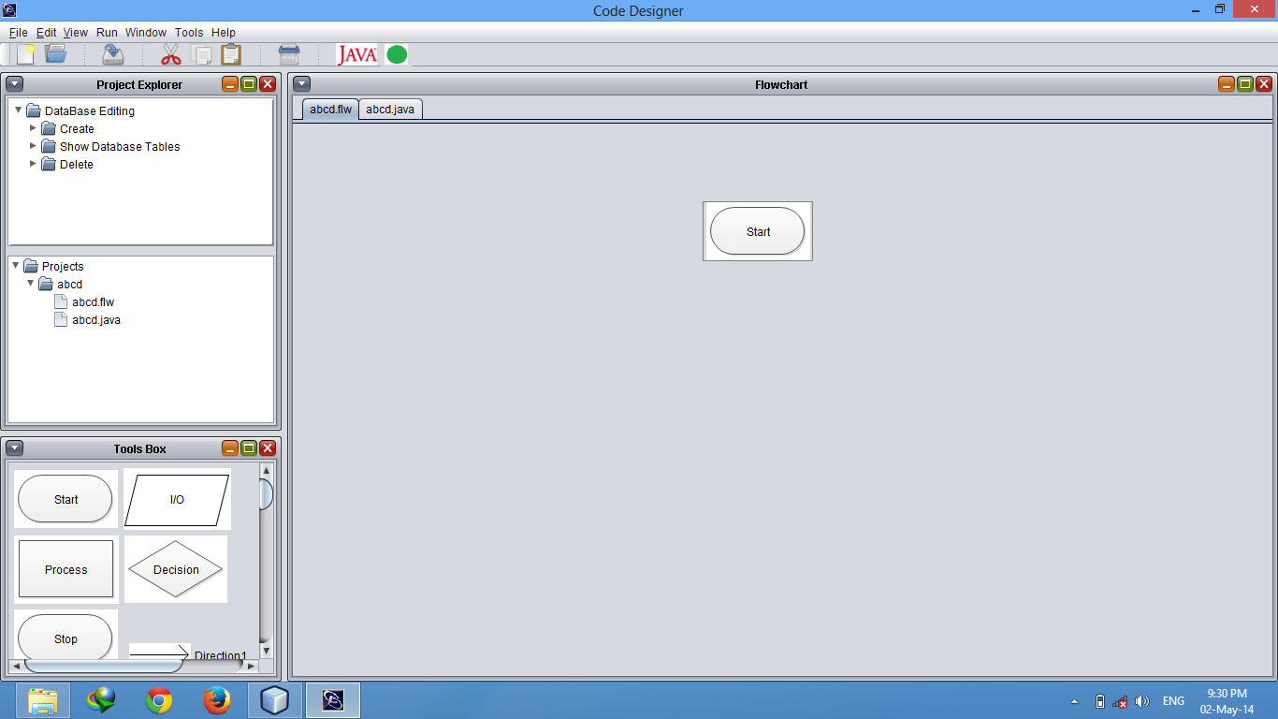

Slide 38
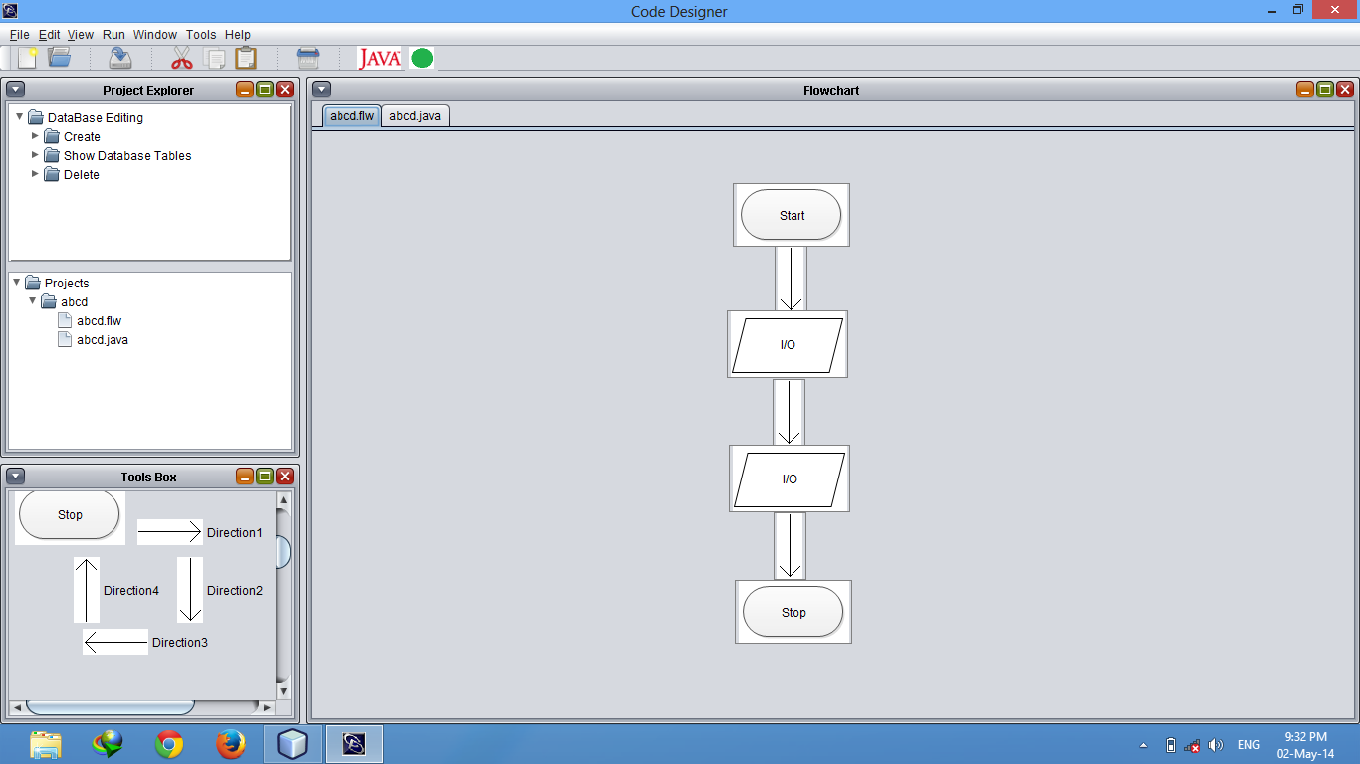

Slide 39
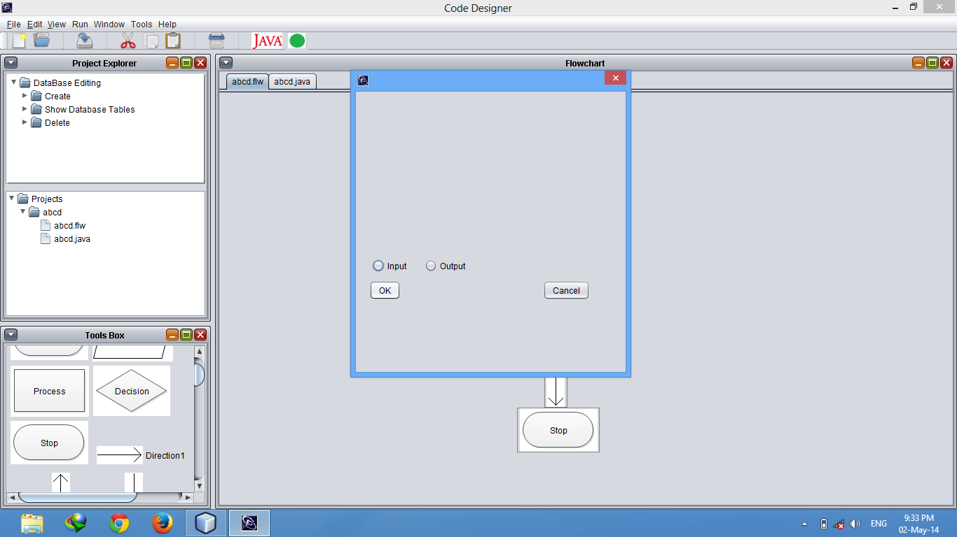

Slide 40


Slide 41


Slide 42


Slide 43


Slide 44
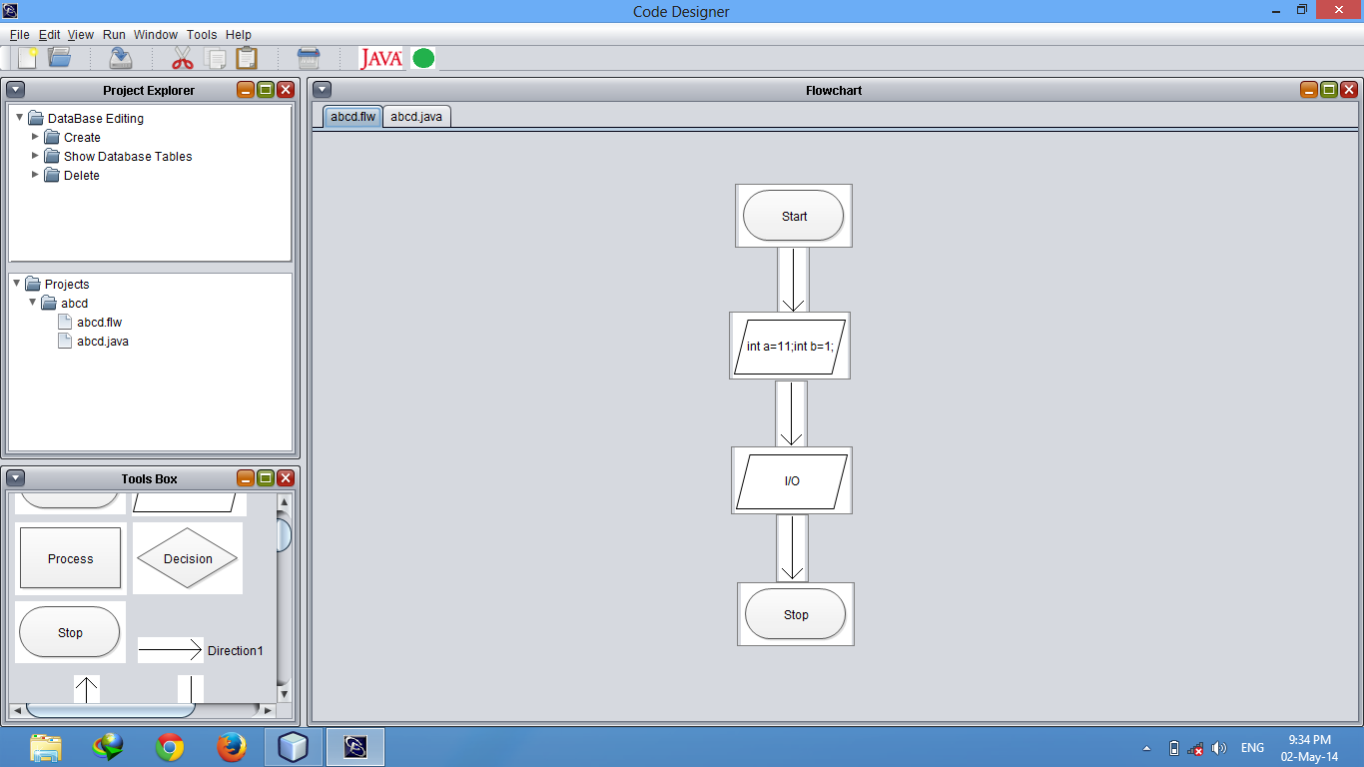

Slide 45


Slide 46


Slide 47
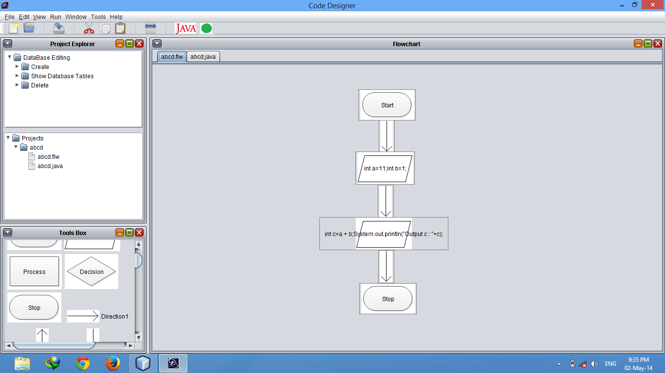

Slide 48
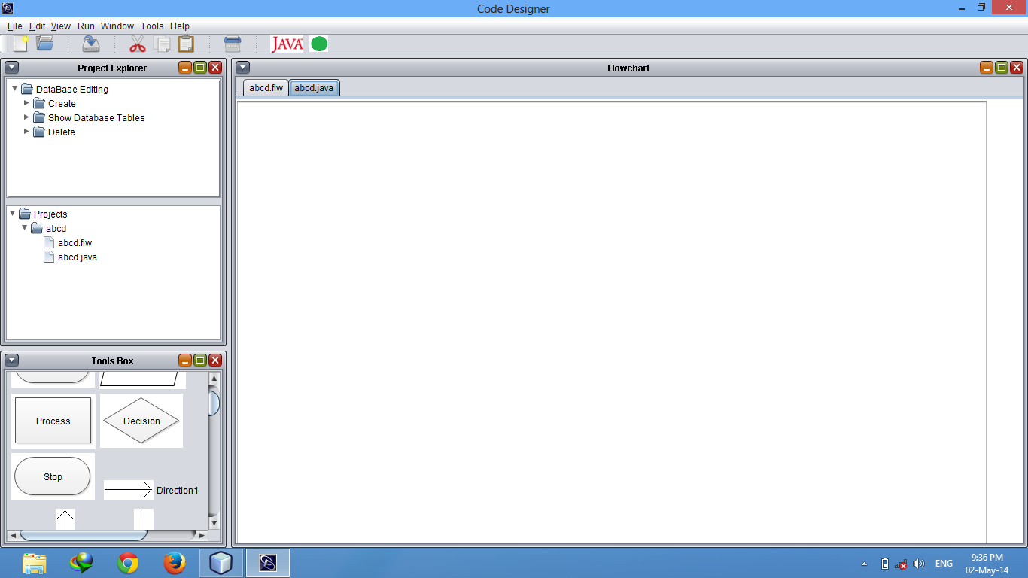

Slide 49
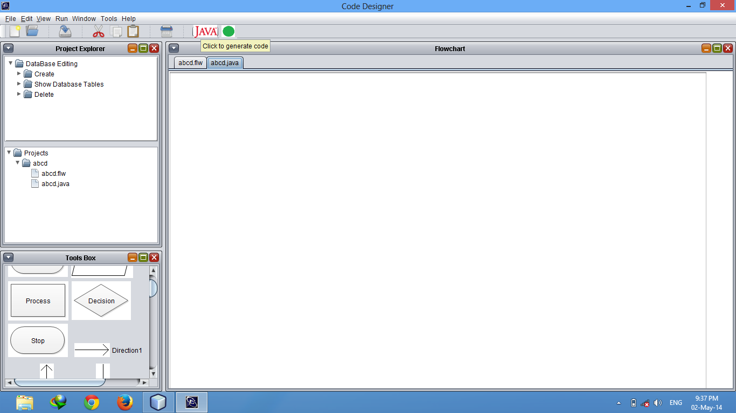

Slide 50
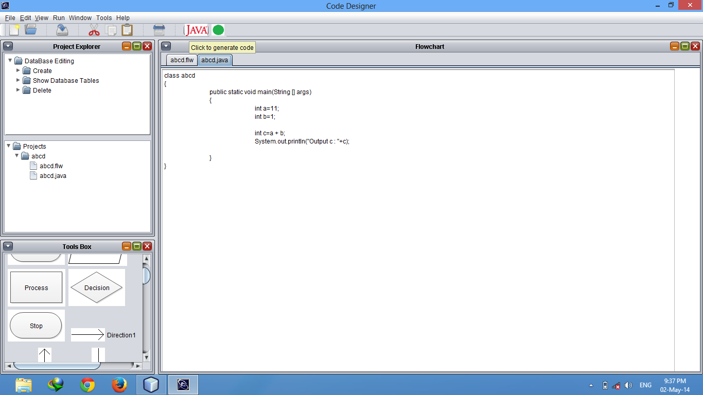

Slide 51
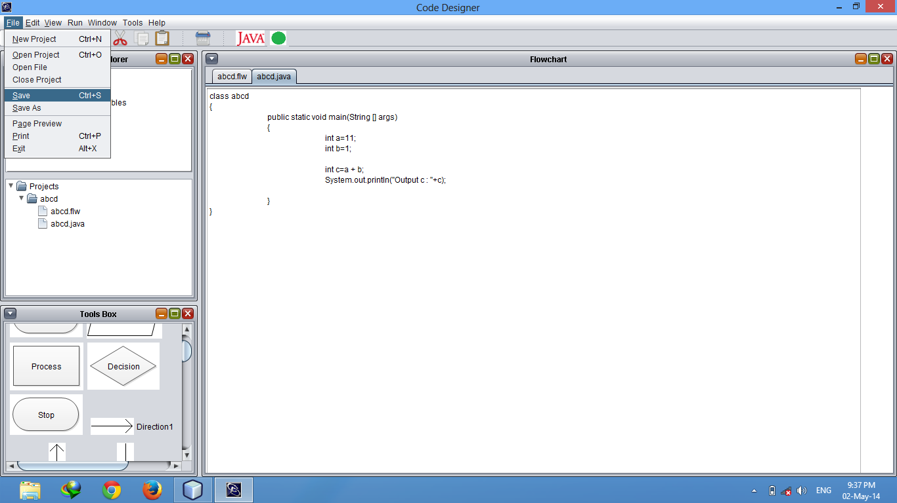

Slide 52
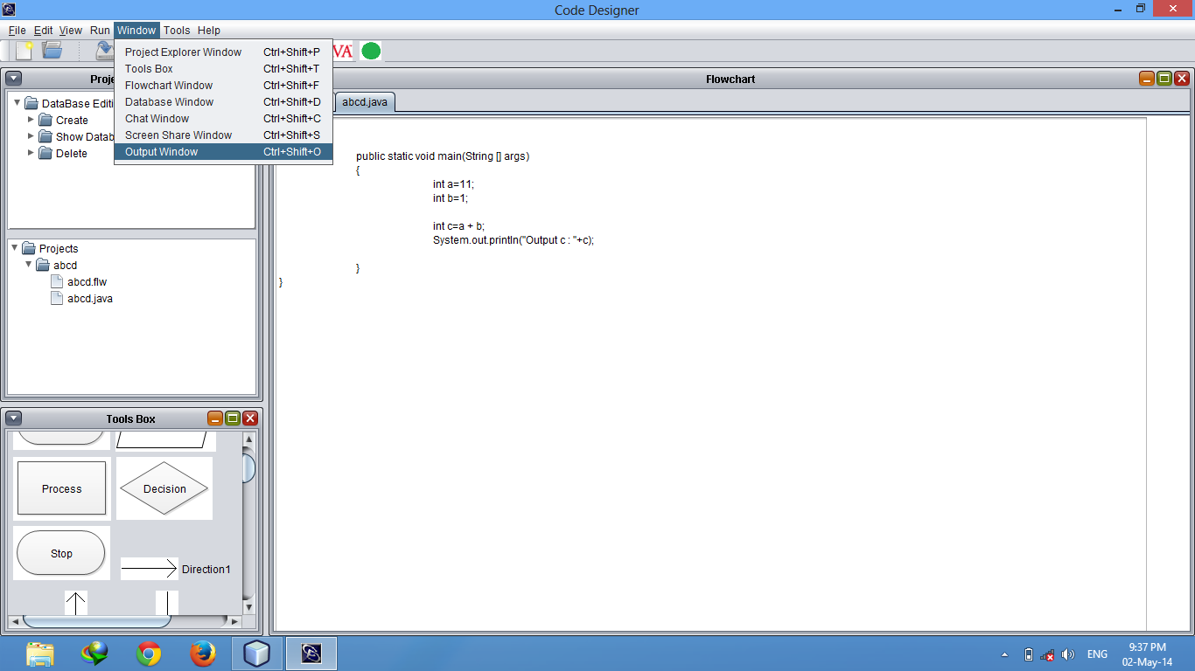

Slide 53
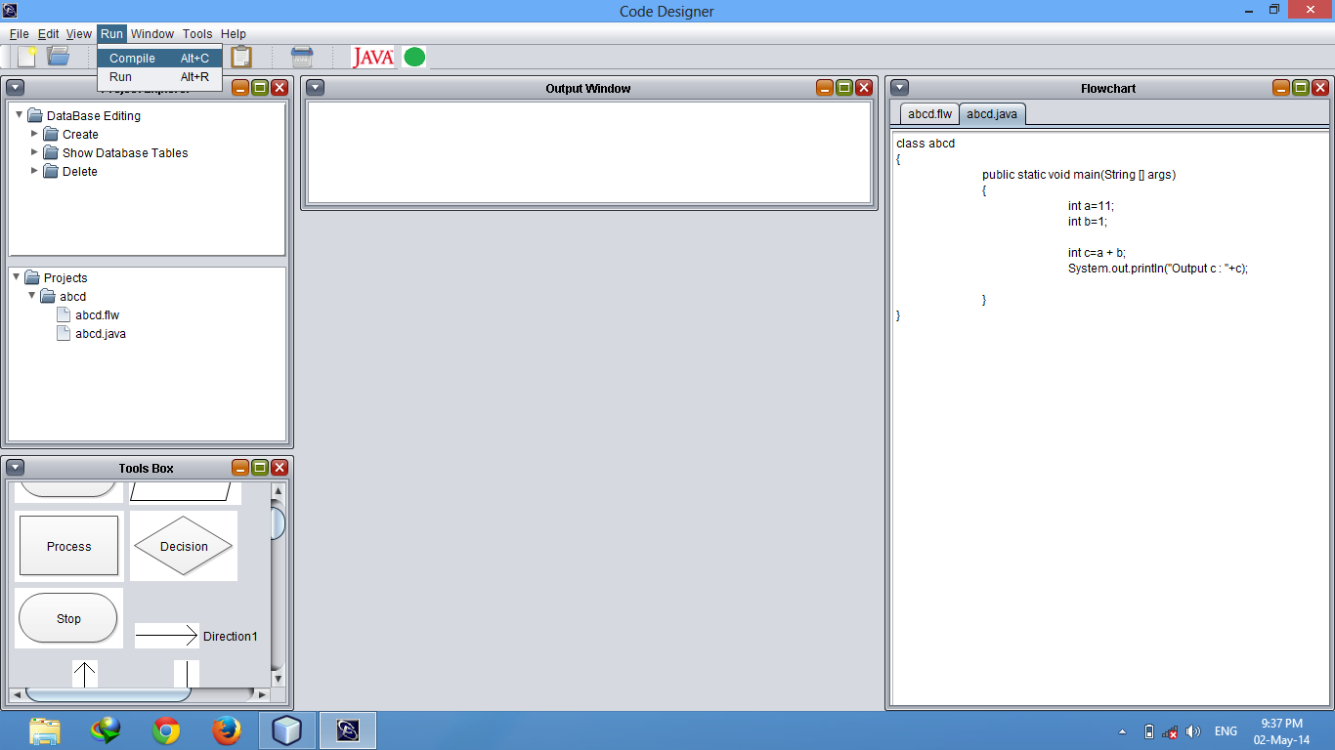

Slide 54
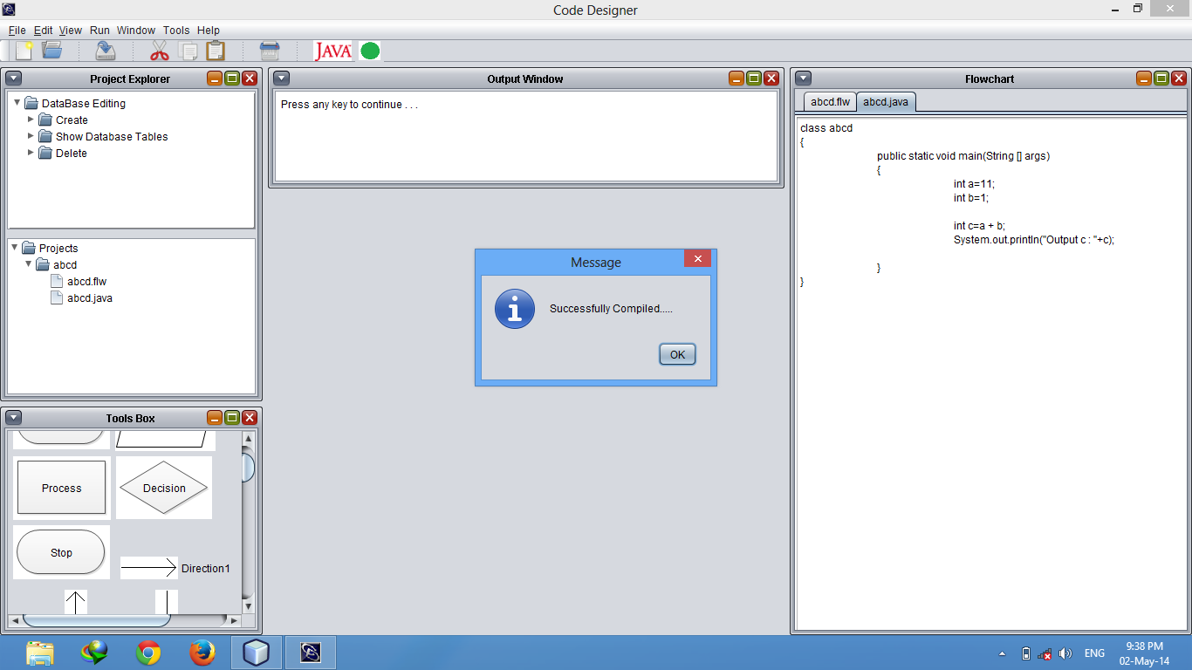

Slide 55


Slide 56
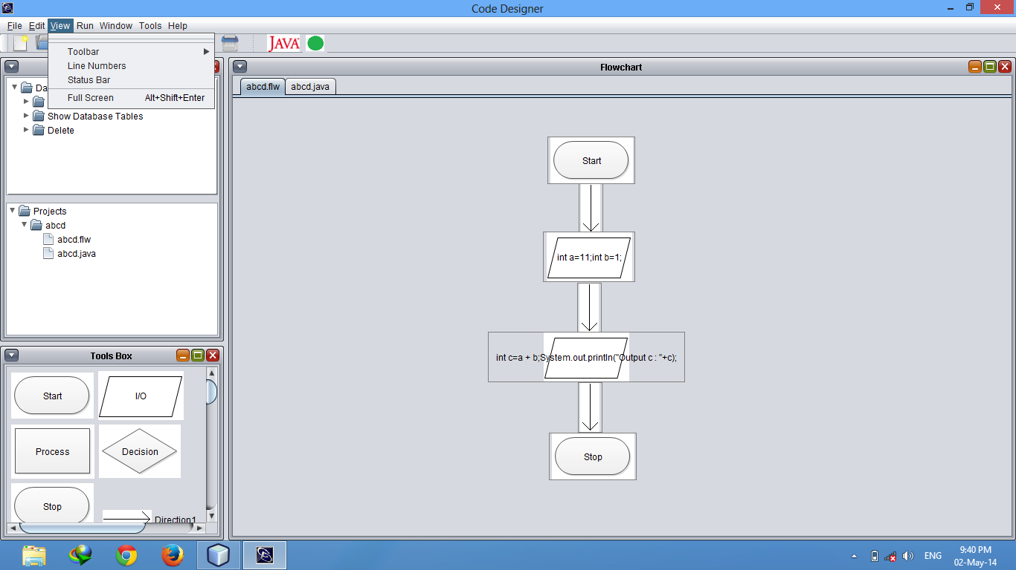

Slide 57
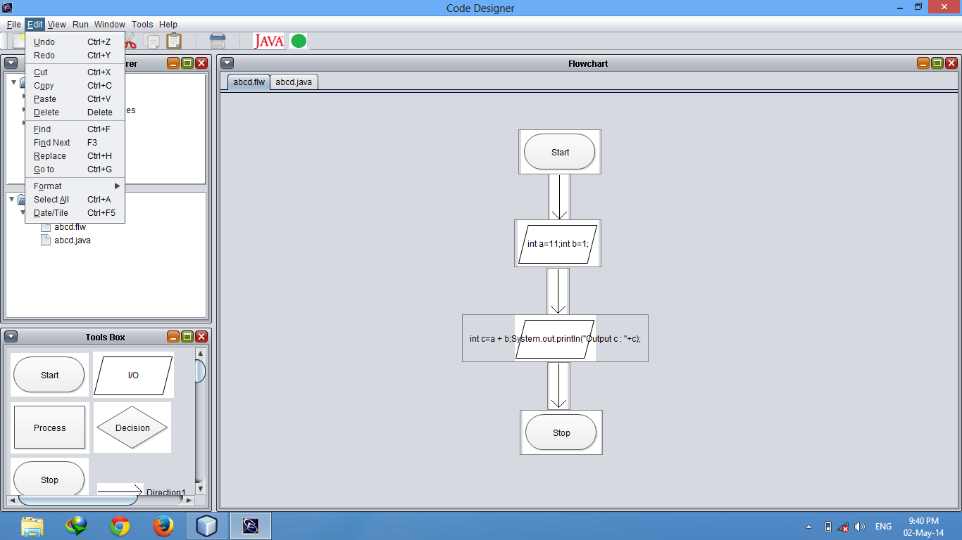

Slide 58
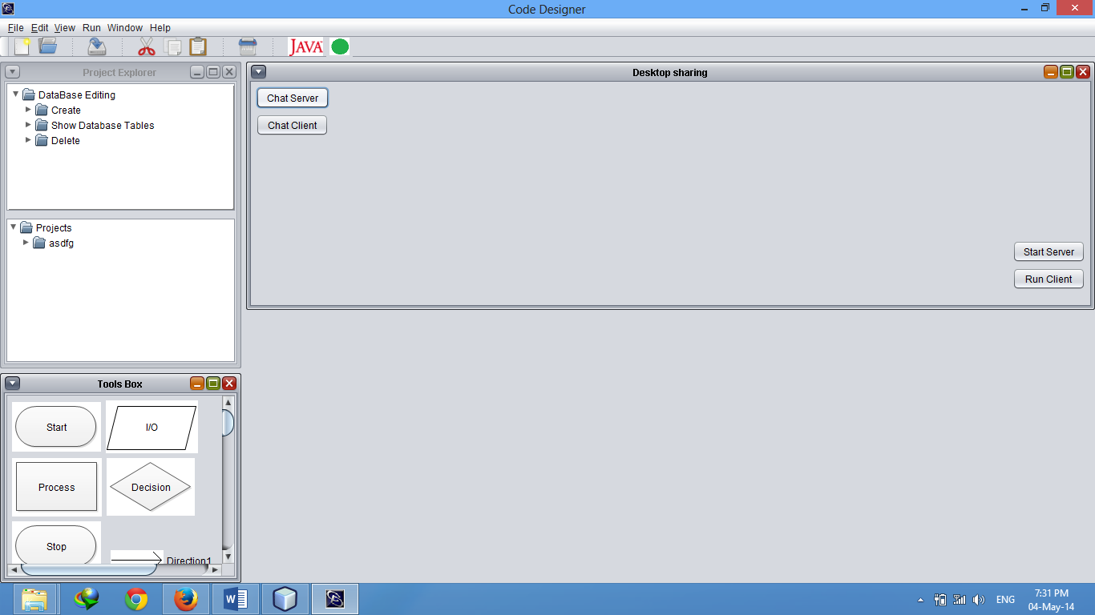

Slide 59
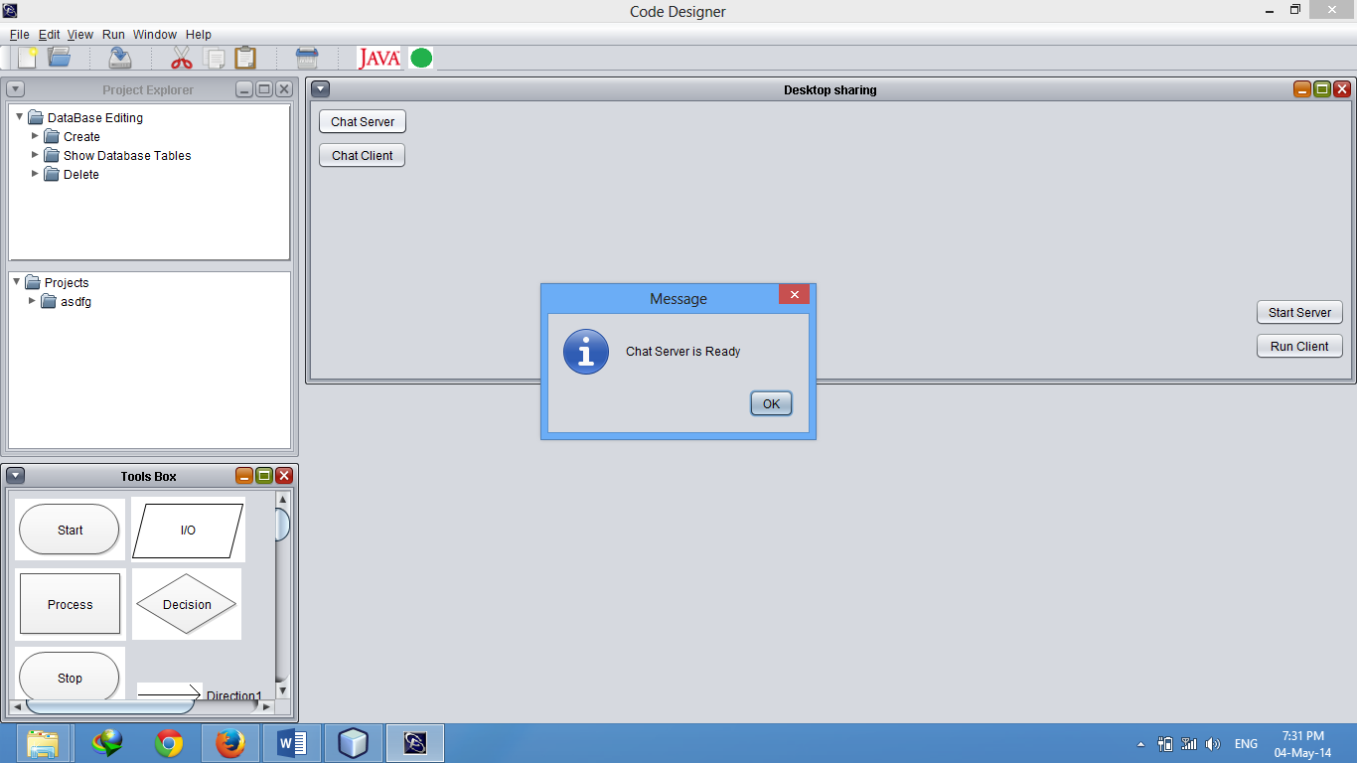

Slide 60
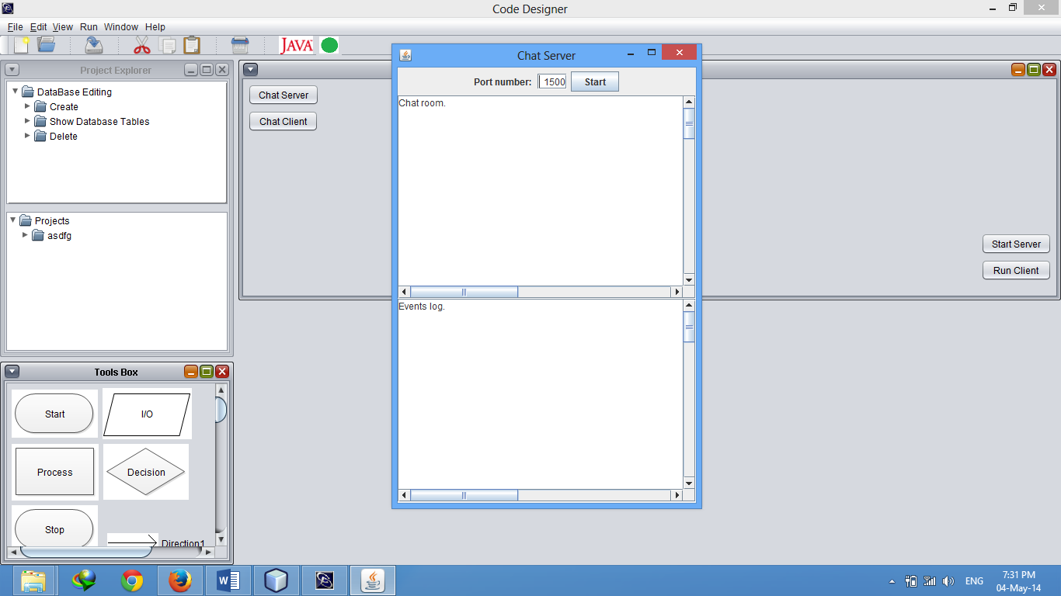

Slide 61


Slide 62
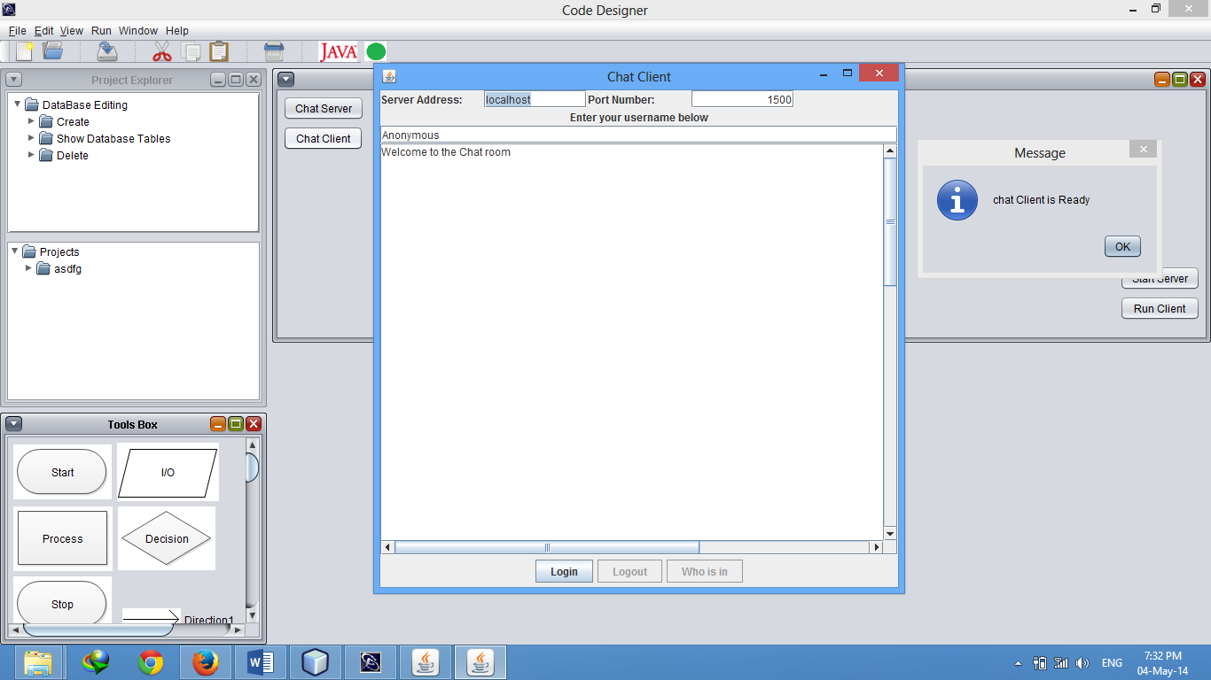

Slide 63
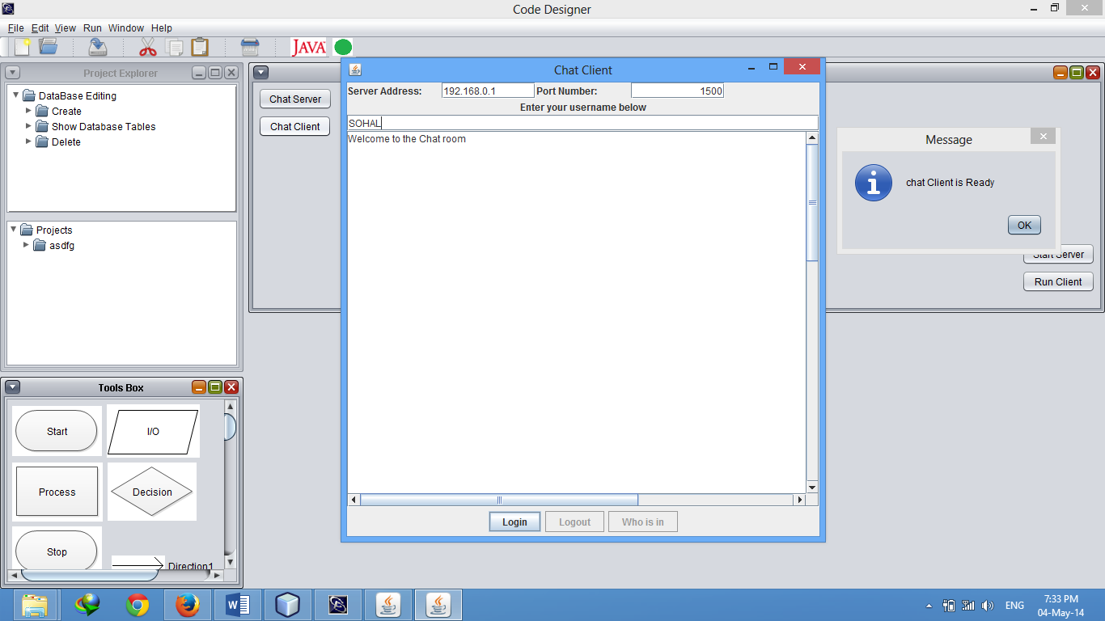

Slide 64
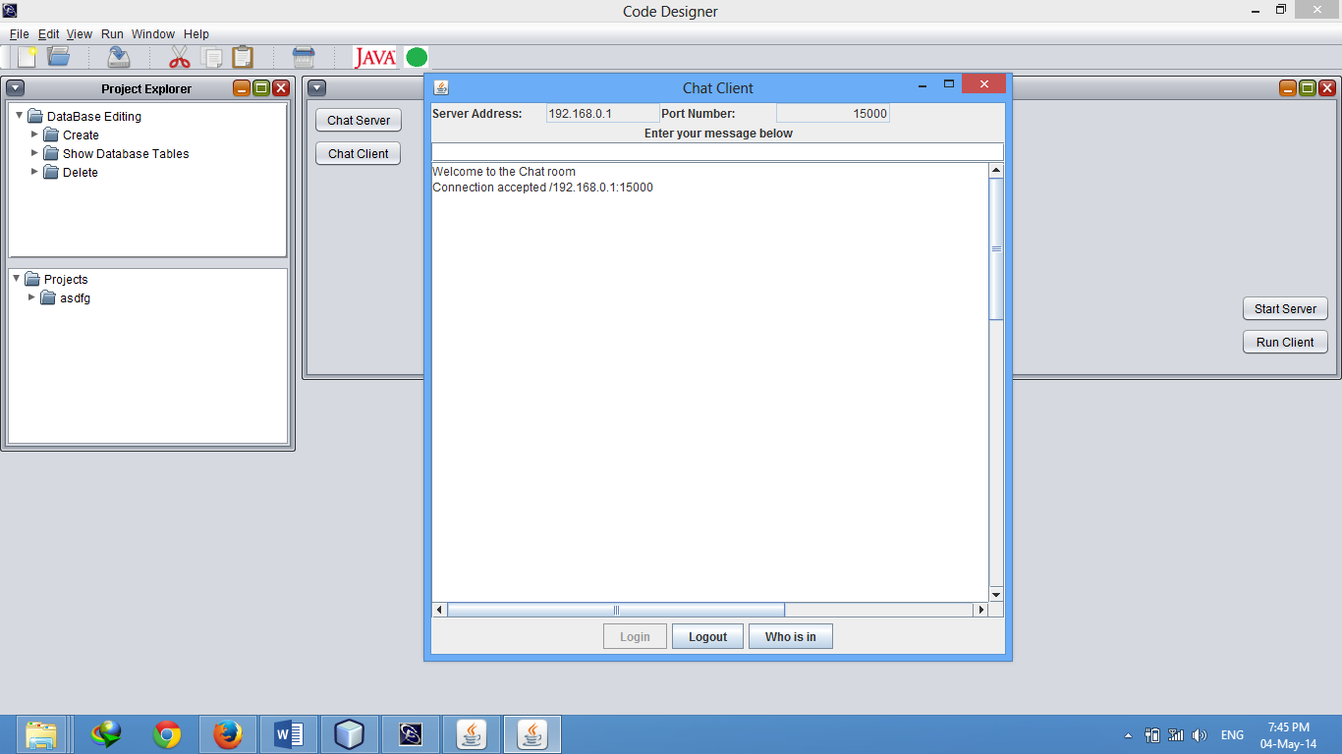

Slide 65
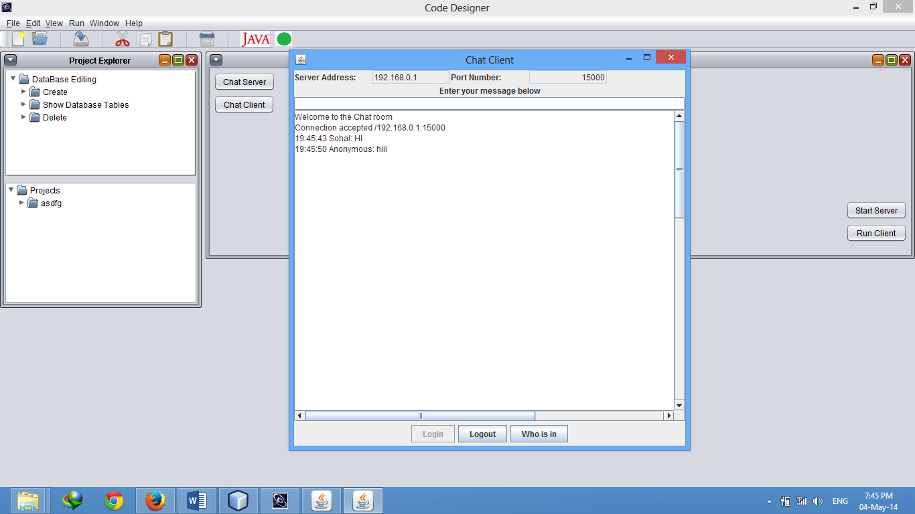

Slide 66
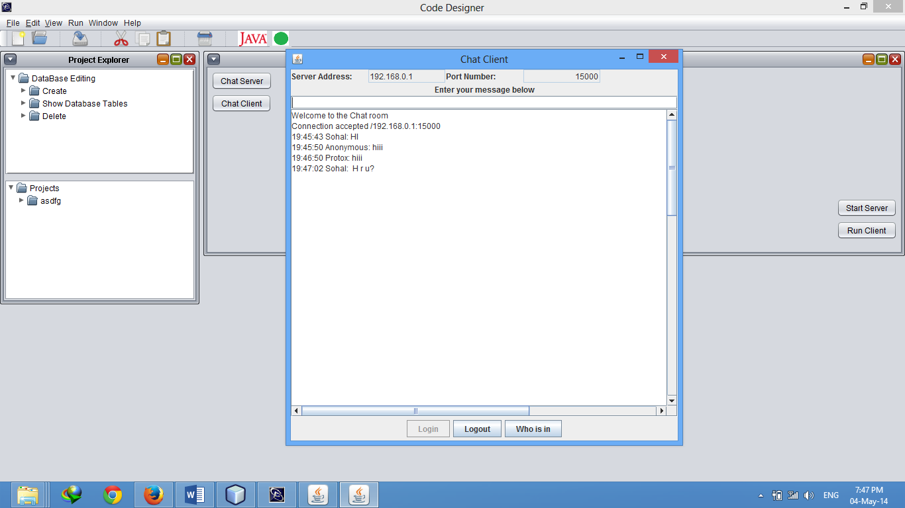

Slide 67
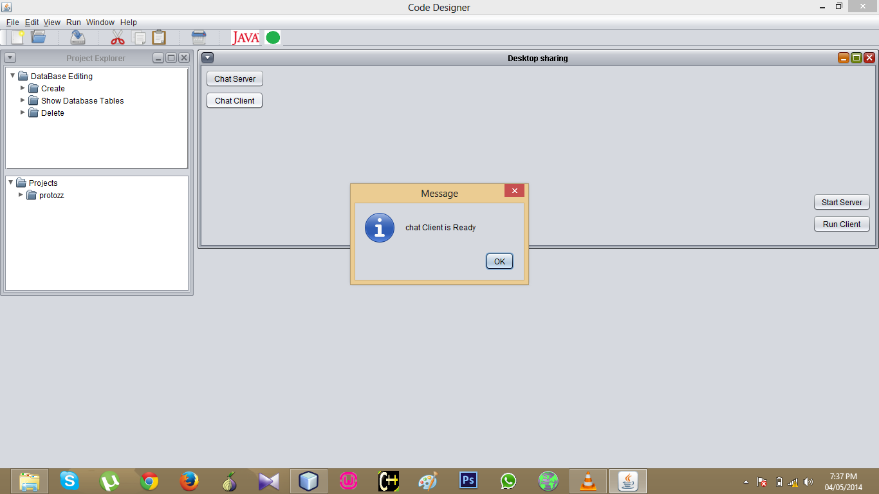

Slide 68
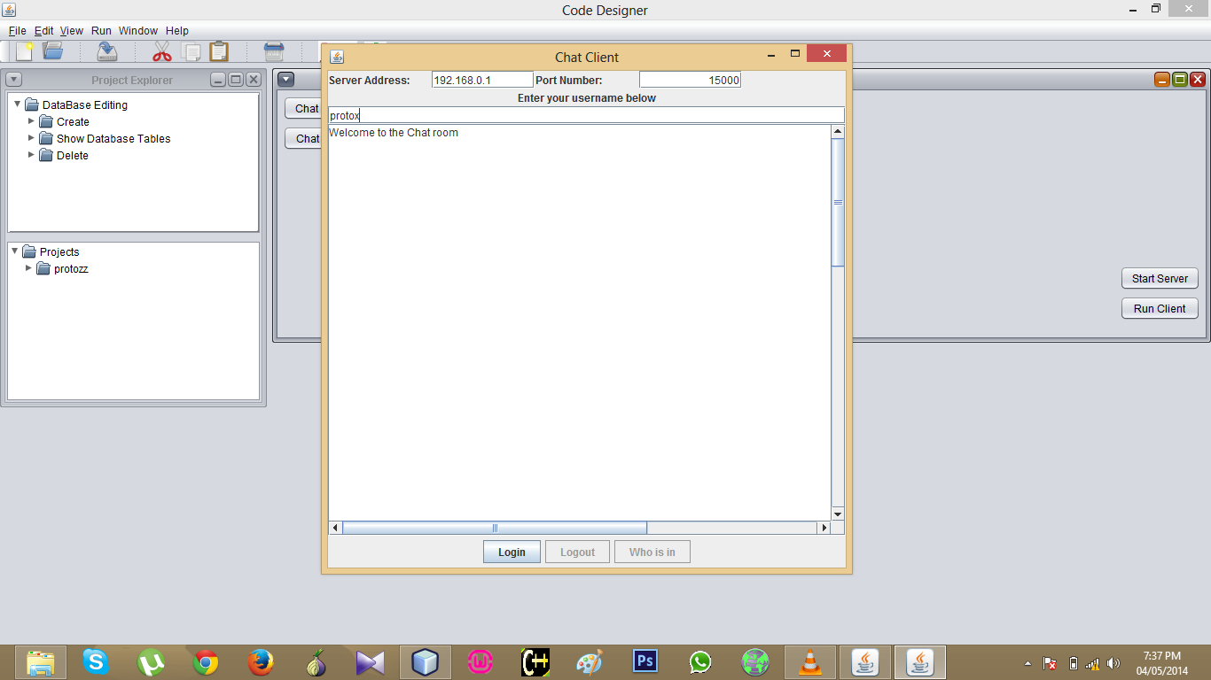

Slide 69
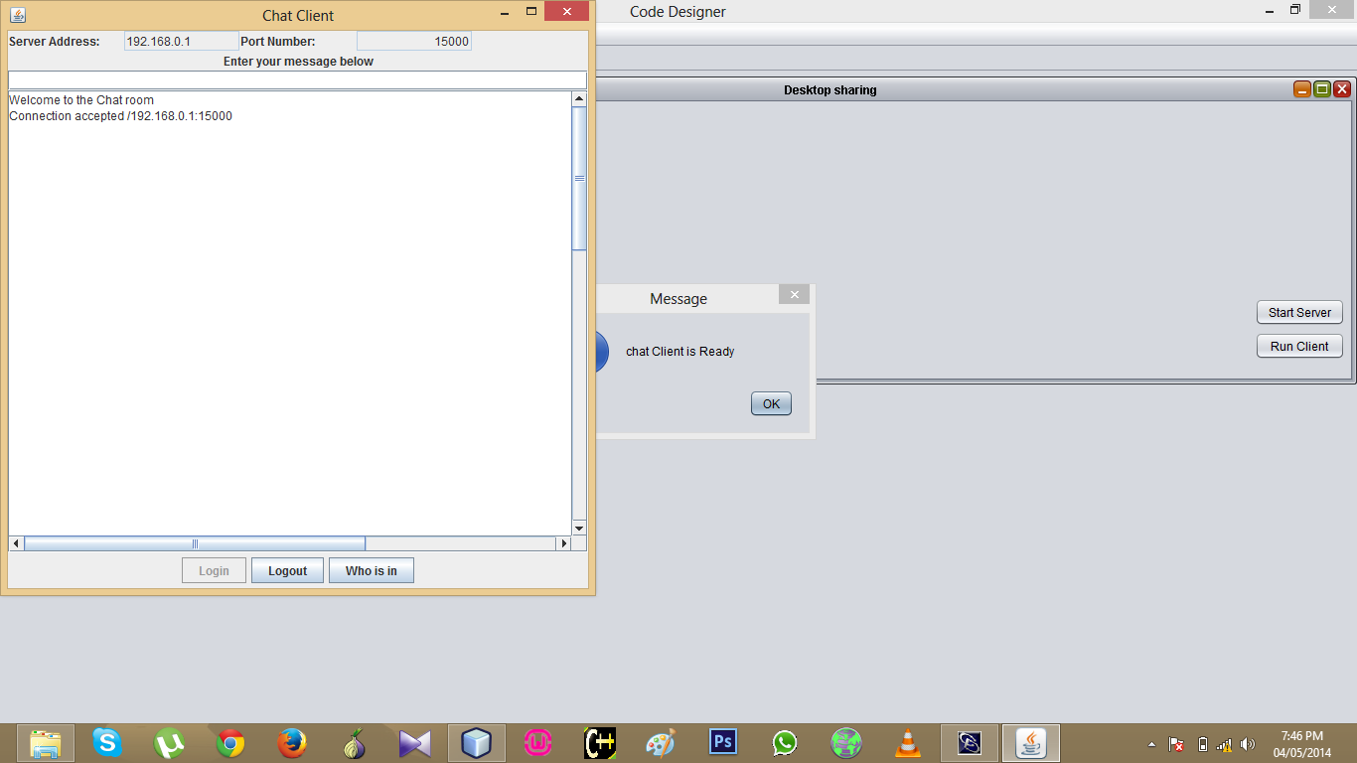

Slide 70
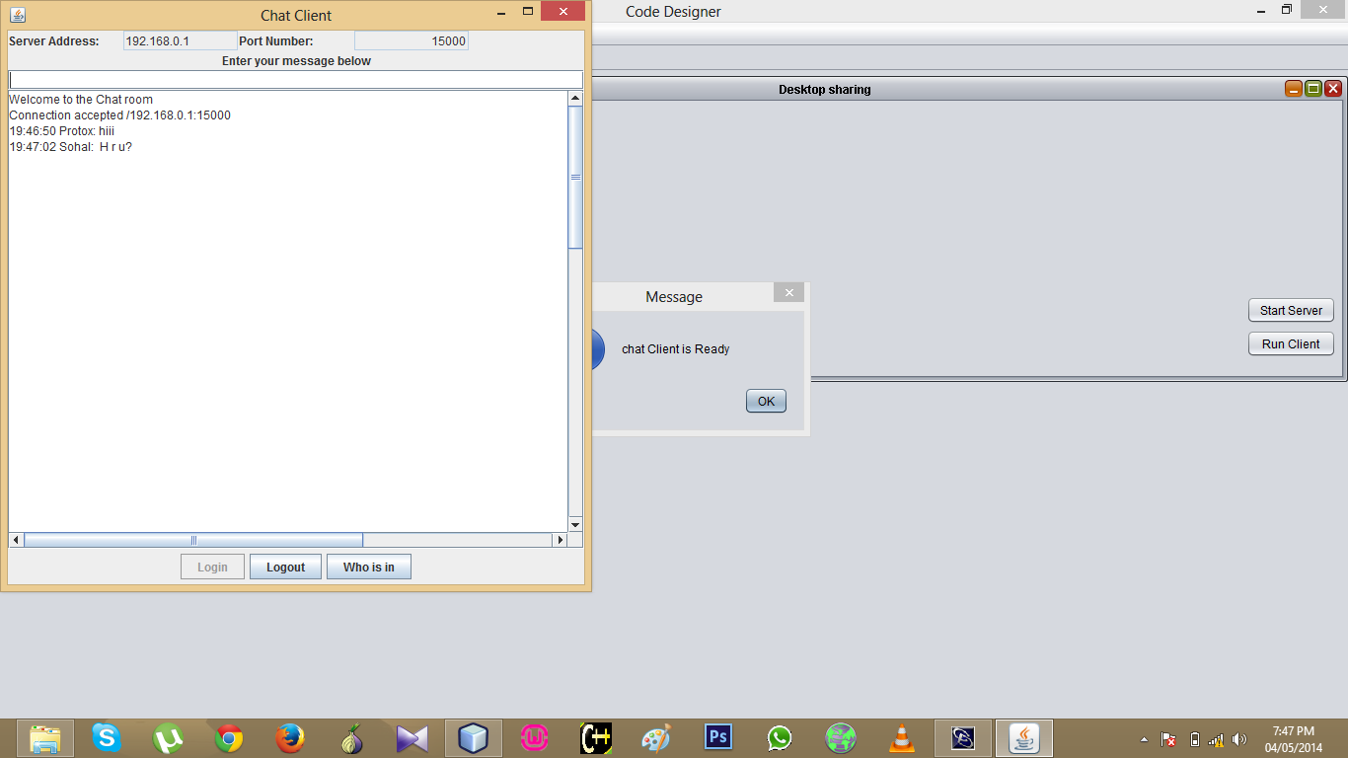

Slide 71
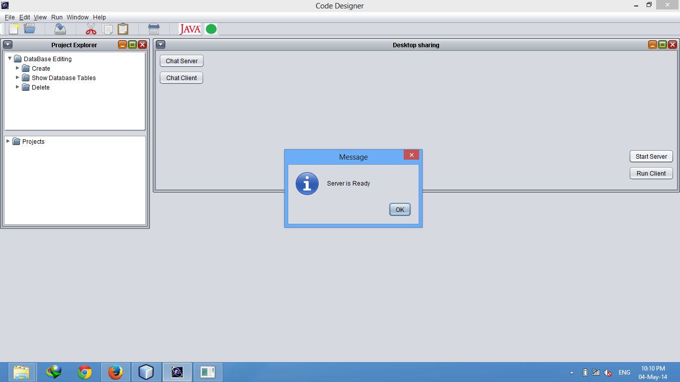

Slide 72
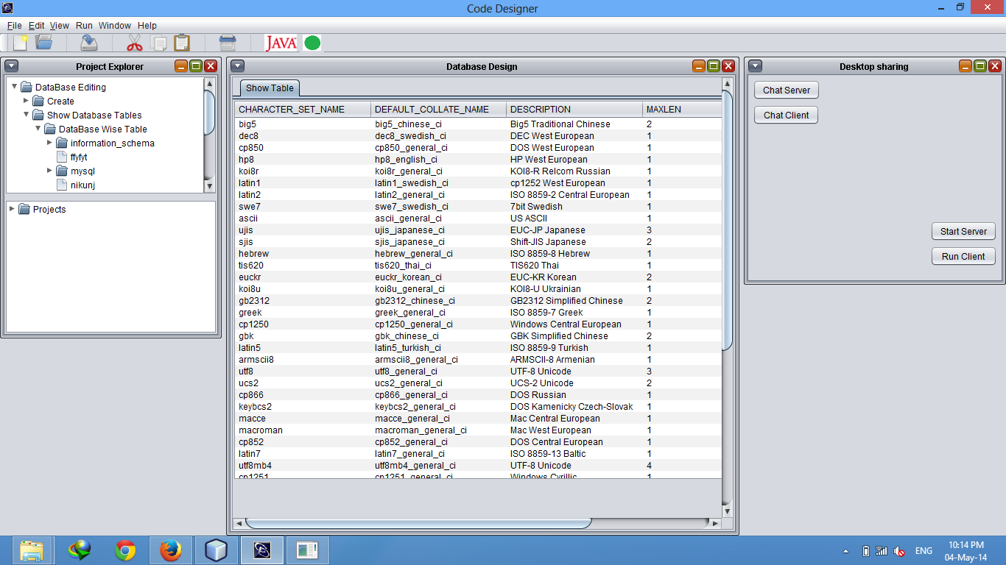

Slide 73
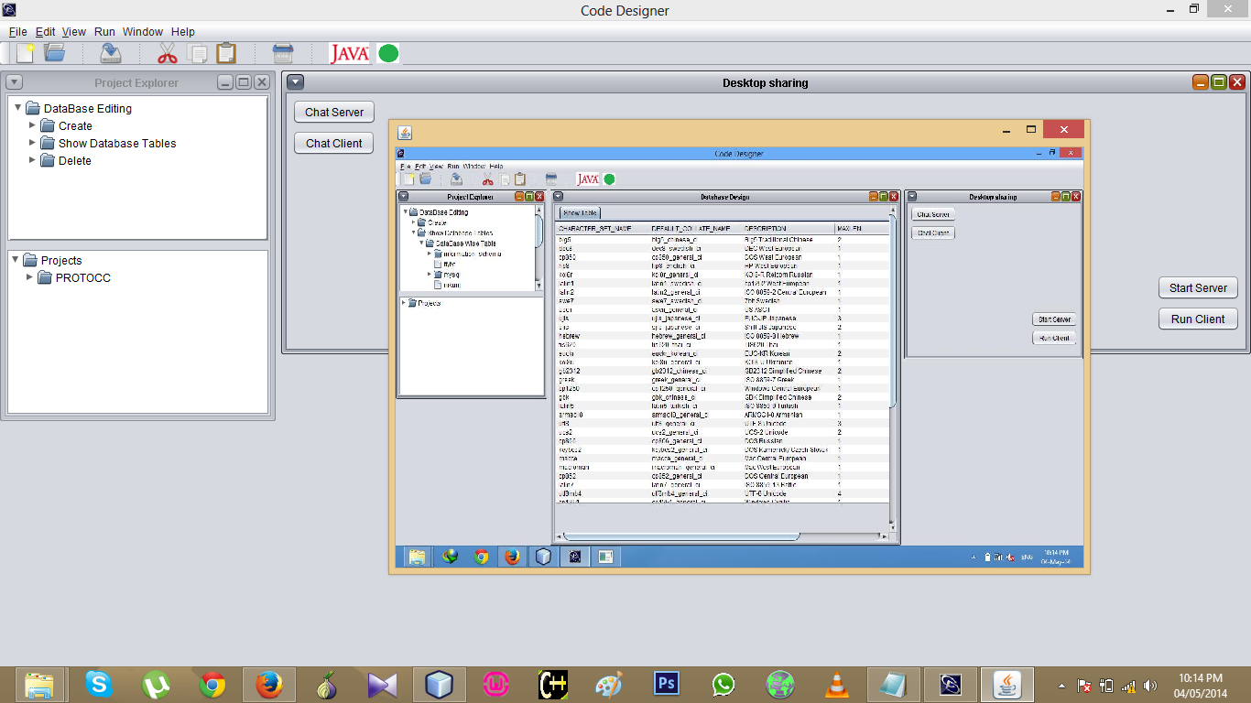

Slide 74
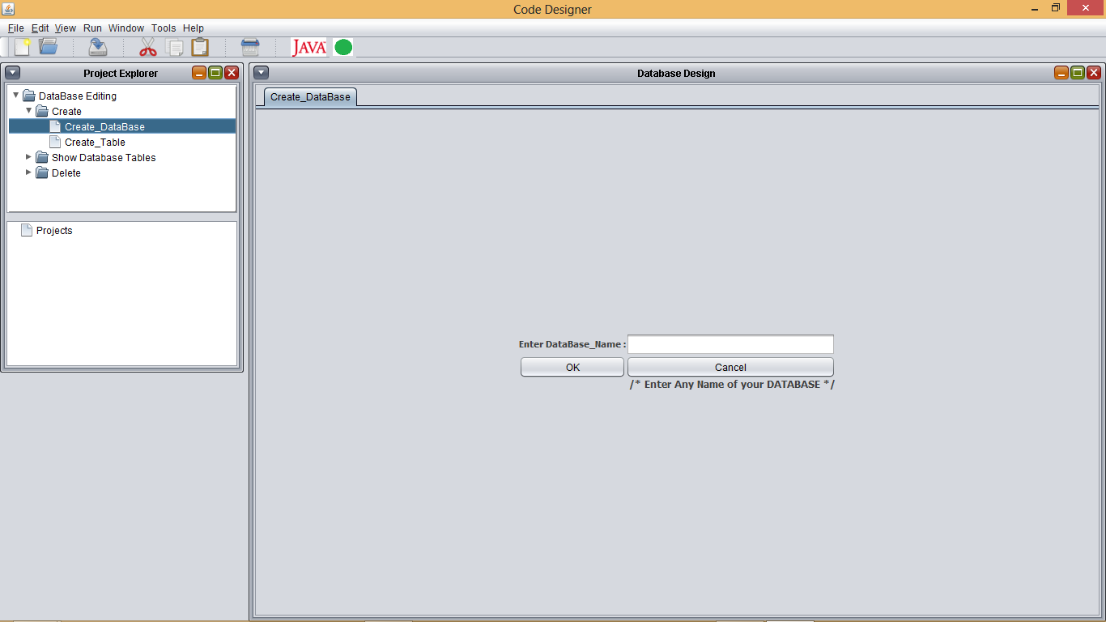

Slide 75
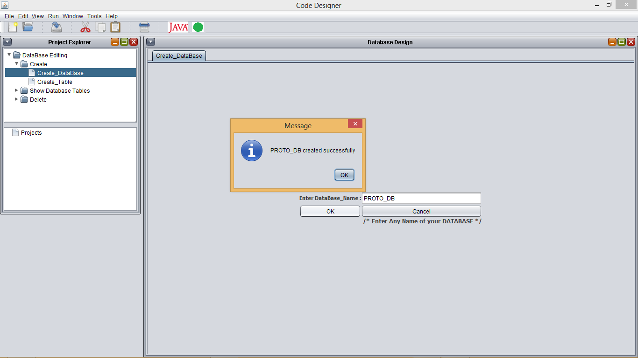

Slide 76
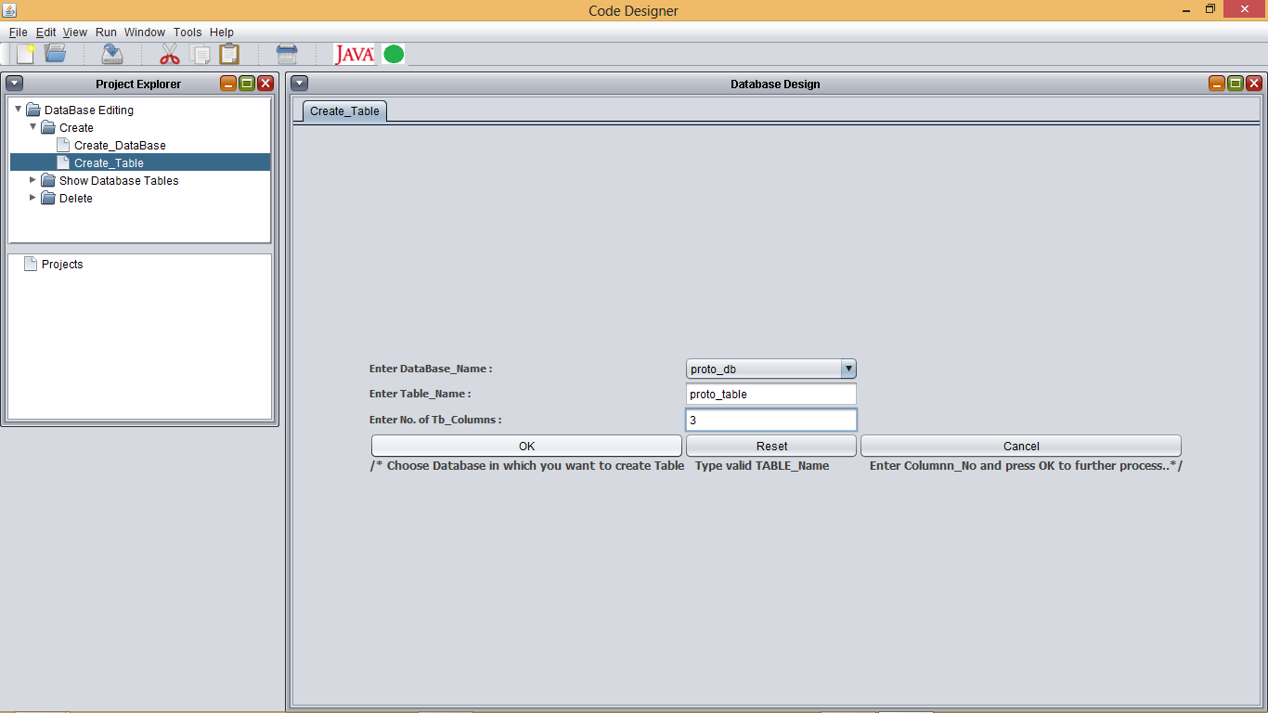

Slide 77
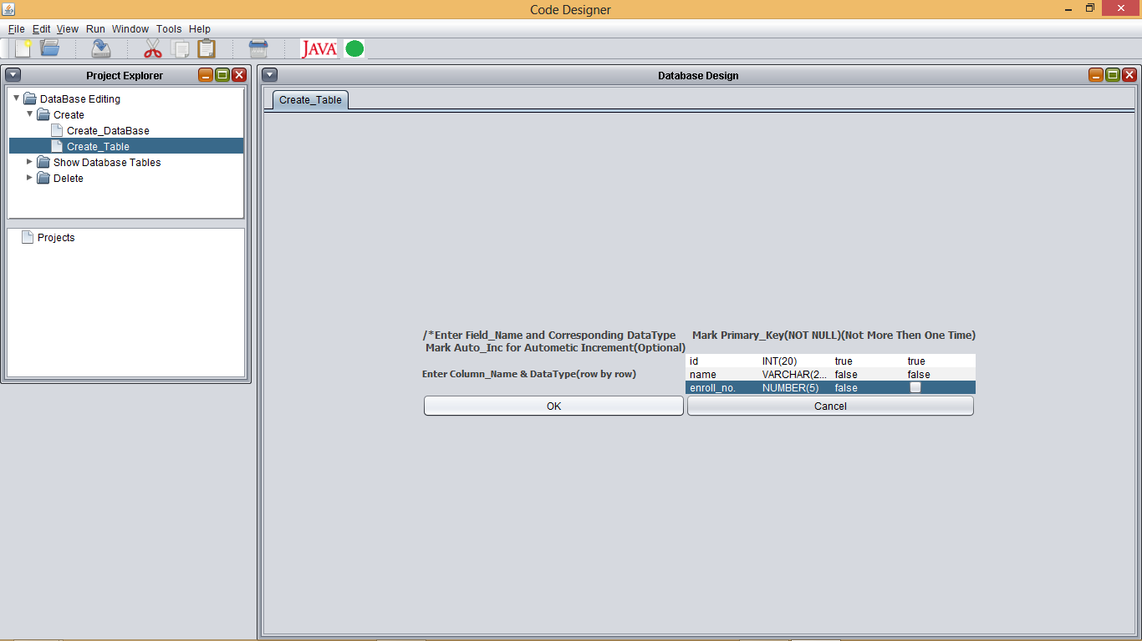

Slide 78
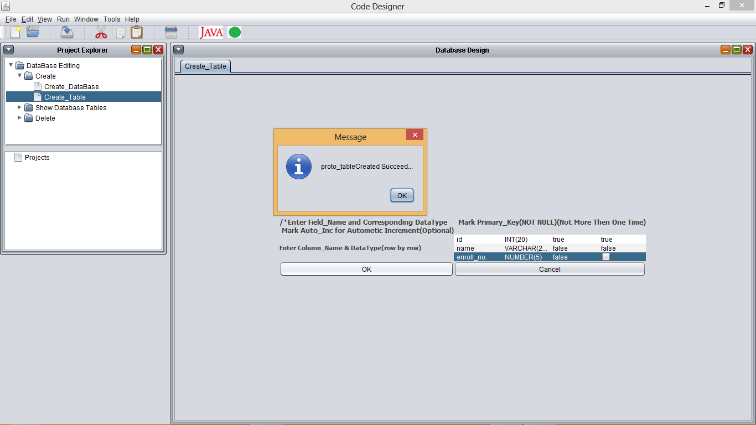

Slide 79
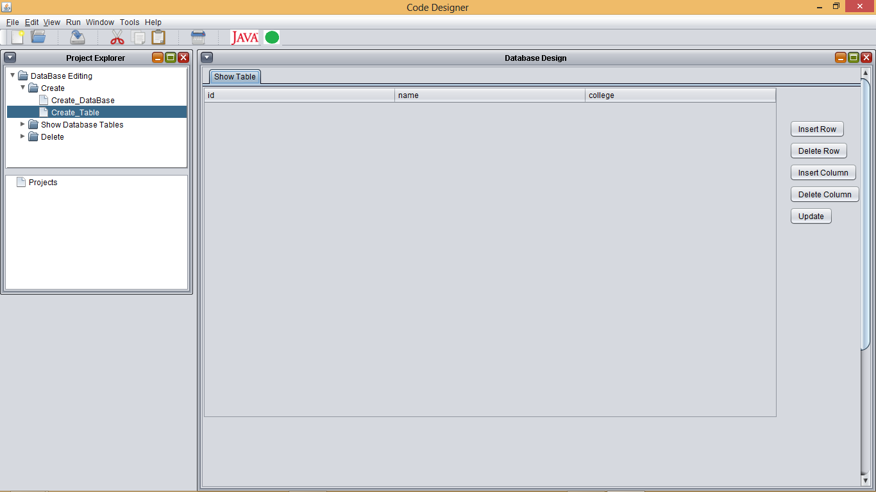

Slide 80
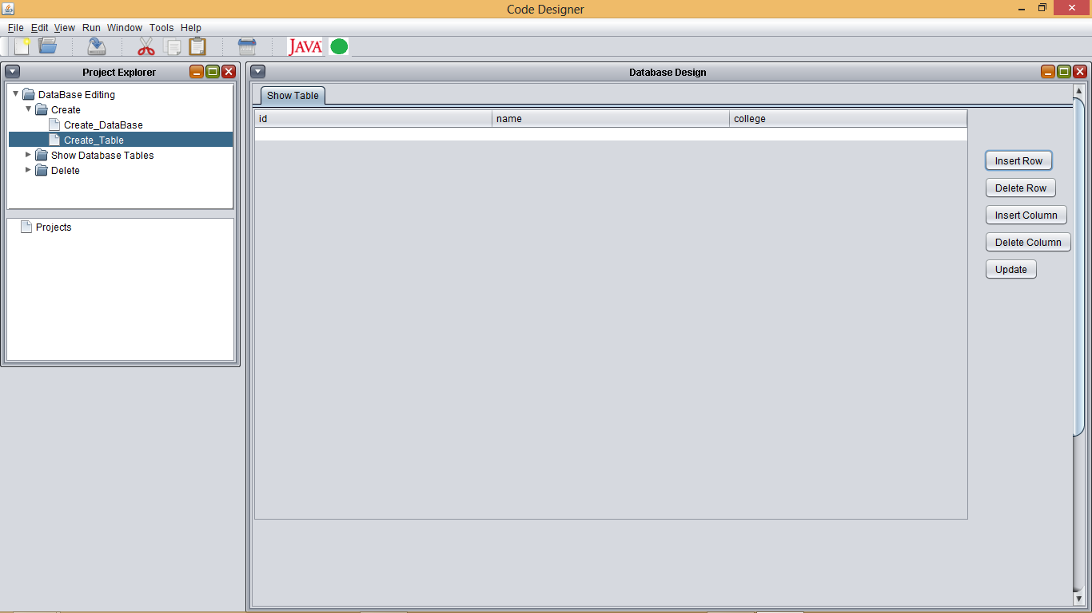

Slide 81
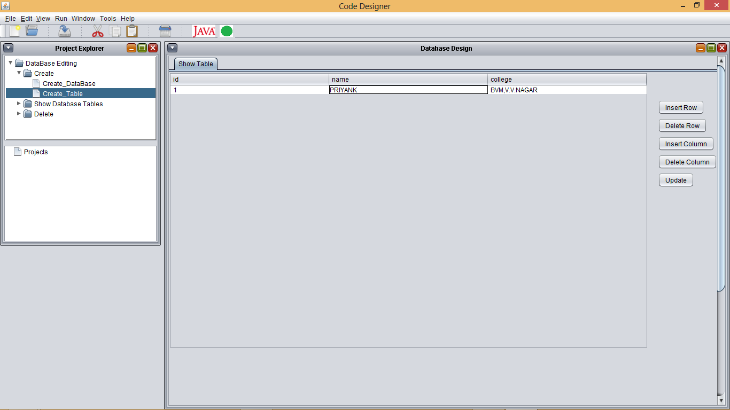

Slide 82
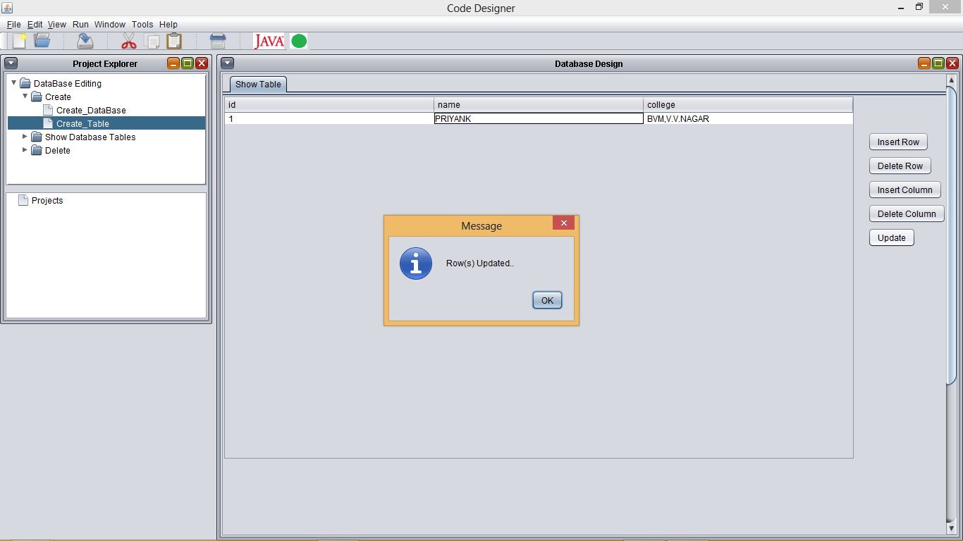

Slide 83
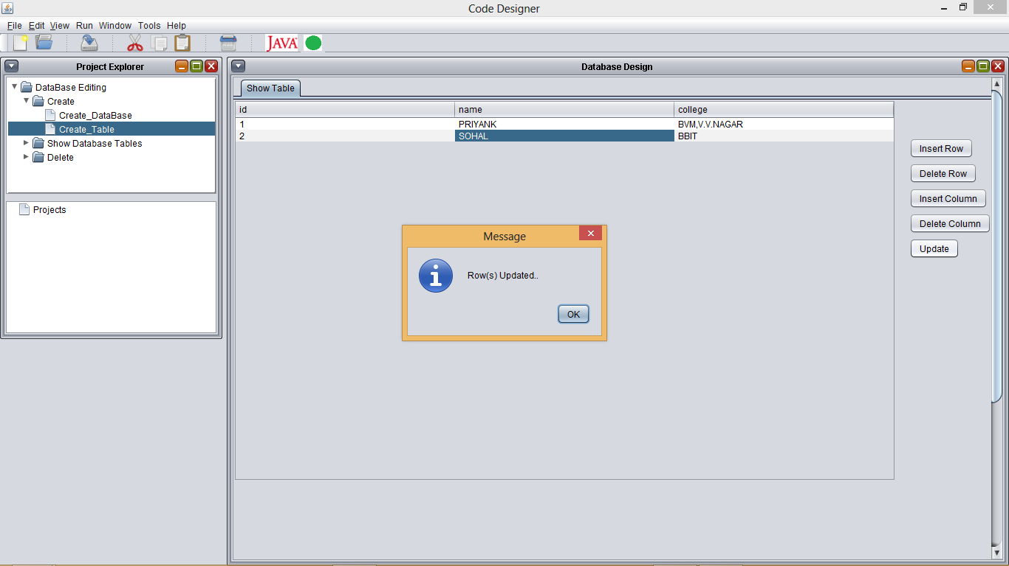

Slide 84
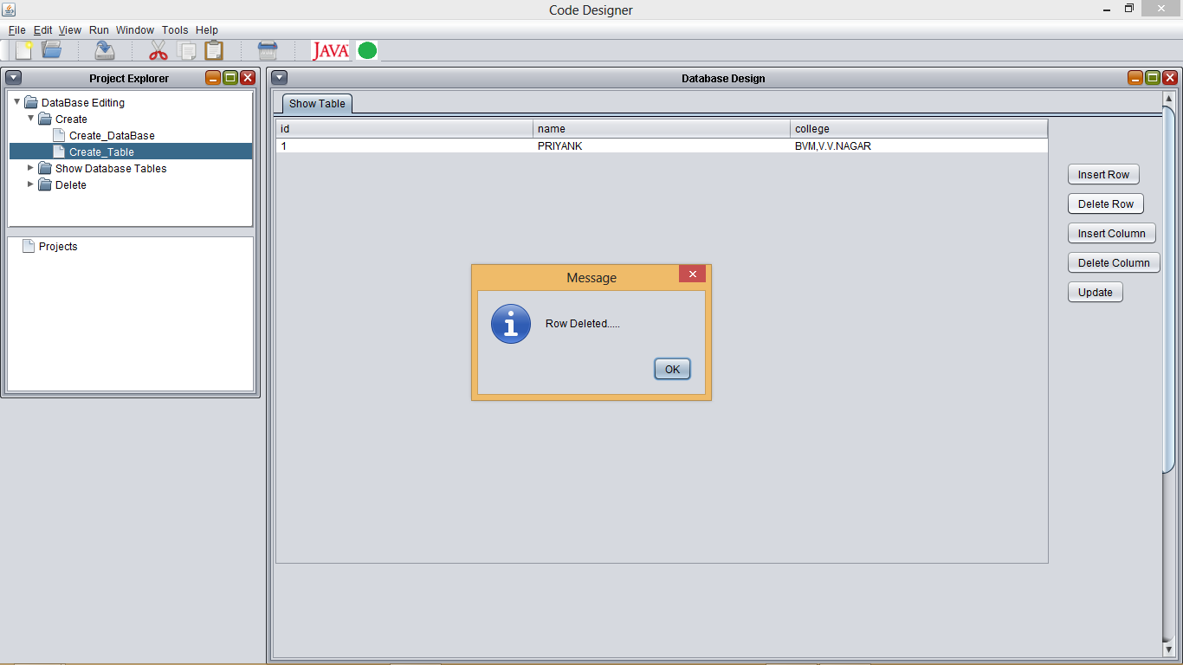

Slide 85
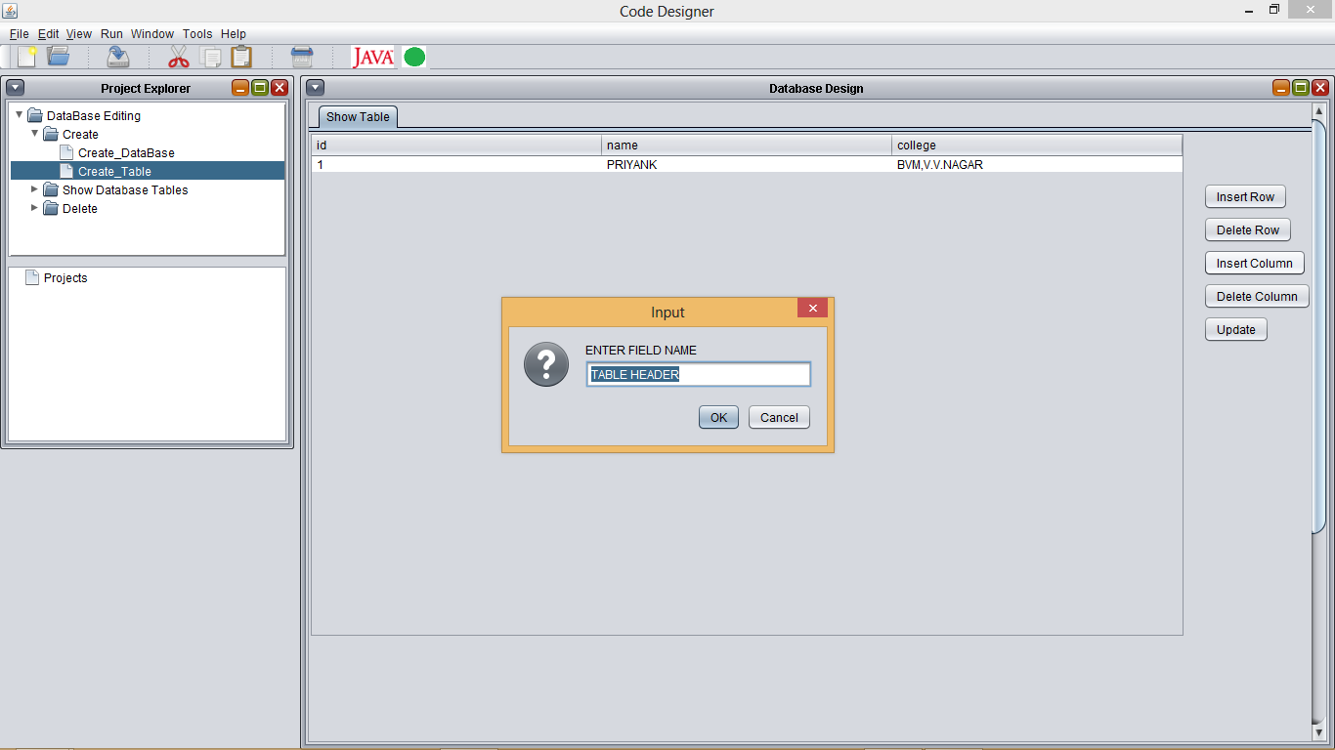

Slide 86
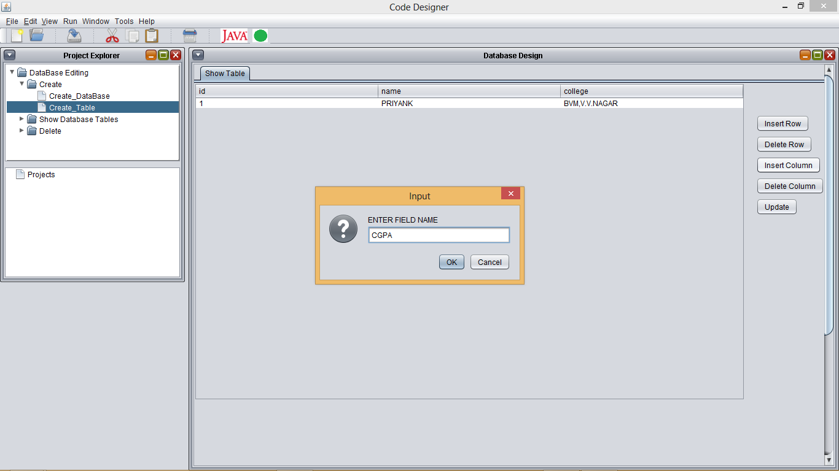

Slide 87
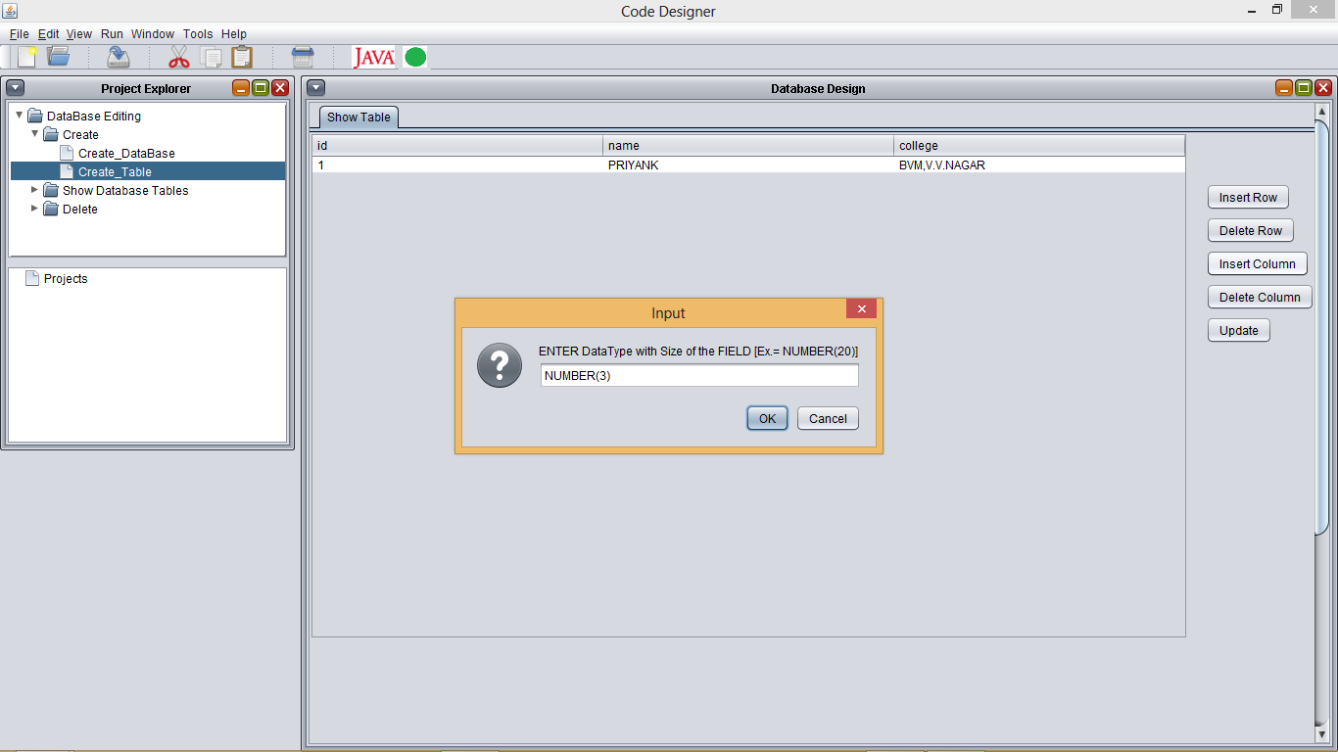

Slide 88


Slide 89


Slide 90


Slide 91


Slide 92


Slide 93


Slide 94


Slide 95


Slide 96


